Slide 1

LEAF DISEASE DETECTION USING DEEP LEARNING & ML TECHNIQUES
<Name of the Students>
Domain: Deep Learning Technology: Python

Slide 2
INDEX
Abstract
Introduction
Literature review
Existing Method
Drawbacks
Proposed method
Advantages
Implementation
Modules
Algorithms
Hardware and Software Requirements
Architecture
UML diagrams

Slide 3
ABSTRACT
Economy contributes the most for the productivity of the agriculture. In agricultural field, the disease in plants is more common and the detection of disease in plants has become more feasible due to the above reason. These days's plant disease detection has acquired enlarging scrutiny in shriveling crops of large and various fields. Farmers undergo significant hassles in chop and changing from one disease administer principle to a different one. We can identify or spotting the tomato leaf diseases for detection for surveillance and monitoring experts is the standard approach for detection. The plants get seriously affected if the proper control hasn't been taken and this represents the quality of the pants the production of the plants will be affected. Detection of disease through some mechanized technique and methodology is efficient and constructive because it decreases an outsized toil of shriveling in the large cultivation. In the premature phase we can detect the symptoms of the plant diseases since their first appearance on their leaves of the plants. By using this paper we can identify the algorithm which is used for image segmentation and for automated classification used for the detection of diseases of leaves in the plants. It also covers distinct disease classification methods of working which is used for the detection of diseases in plants.

Slide 4
INTRODUCTION
The automated identification of plant diseases based on plant leaves is a major landmark in the field of agriculture. Moreover, the early and timely identification of plant diseases positively impacts crop yield and quality. Due to the cultivation of a large number of crop products, even an agriculturist and pathologist may often fail to identify the diseases in plants by visualizing disease-affected leaves. However, in the rural areas of developing countries, visual observation is still the primary approach of disease identification. It also requires continuous monitoring by experts. In remote areas, farmers may need to travel far to consult an expert, which is time-consuming and expensive. Automated computational systems for the detection and diagnosis of plant diseases assist farmers and agronomists with their high throughput and precision. In order to overcome the above problems, researchers have thought of several solutions. Various types of feature sets can be used in machine learning for the classification of plant diseases. Among these, the most popular feature sets are traditional handcrafted and deep-learning (DL)-based features. Pre-processing, such as image enhancement, color transformation, and segmentation, is a prerequisite before efficiently extracting features. After feature extraction, different classifiers can be used.

Slide 5
INTRODUCTION
The occurrence of plant diseases has a negative impact on agricultural production. If plant diseases are not discovered in time, food insecurity will increase. Early detection is the basis for effective prevention and control of plant diseases, and they play a vital role in the management and decision making of agricultural production. In recent years, plant disease identification has been a crucial issue. Disease-infected plants usually show obvious marks or lesions on leaves, stems, flowers, or fruits. Generally, each disease or pest condition presents a unique visible pattern that can be used to uniquely diagnose abnormalities. Usually, the leaves of plants are the primary source for identifying plant diseases, and most of the symptoms of diseases may begin to appear on the leaves. In most cases, agricultural and forestry experts are used to identify on-site or farmers identify fruit tree diseases and pests based on experience. This method is not only subjective, but also time-consuming, laborious, and inefficient. Farmers with less experience may misjudgment and use drugs blindly during the identification process. Quality and output will also bring environmental pollution, which will cause unnecessary economic losses. To counter these challenges, research into the use of image processing techniques for plant disease recognition has become a hot research topic.

Slide 6
LITERATURE SURVEY
S. No | Journal Type with year | Authors | Title | Outcomes
1 | 2018, ICDI3C | Maniyath, S. R., P V, V., M, N., R, P., N, P. B., N, S., & Hebbar, R. | Plant Disease Detection Using Machine Learning | First for any image we need to convert RGB image into gray scale image. This is done just because Hu moments shape descriptor and Haralick features can be calculated over single channel only. Therefore, it is necessary to convert RGB to gray scale before computing Hu moments and Haralick features.
2 | 2021,Electronics | Hassan, S. M., Maji, A. K., Jasiński, M., Leonowicz, Z., & Jasińska, E. | Identification of Plant-Leaf Diseases Using CNN and Transfer-Learning Approach | classification of plant diseases using diseased leaves of plants. However, there is still no efficient and effective commercial solution that can be used to identify the diseases. In our work, we used four different DL models for the detection of plant diseases using healthy- and diseased-leaf images of plants.
3 | 2021, IntechOpen | Muhammad E.H. Chowdhury, Tawsifur Rahman, Amith Khandakar, Nabil Ibtehaz | Tomato Leaf Diseases Detection Using Deep Learning Technique | Infinite possibilities of machine learning for agriculture applications, complete with case studies. ResNet, MobileNet, DenseNet201, and InceptionV3 are examples of state-of-the-art pre-trained CNN models that do an excellent work of classifying diseases from plant leaf images. When compared to other architectures, the DenseNet201 was found to be better at extracting discriminative features from images
4 | 2020,IEEE | Zhang, Y., Song, C., & Zhang., D | Deep Learning-Based Object Detection Improvement for Tomato Disease | Faster RCNN algorithm to detect diseased tomato leaves, which can both recognize tomato diseases and detect tomato leaf locations. To make the anchors in the algorithm closer to the ground truth of our dataset, we use the k-means algorithm to cluster the bounding boxes of tomato disease images and improve the anchors based on the results.

Slide 7
EXISTING SYSTEM
This model emphasizes an existing method that which is designed using the some of the algorithms of deep learning. Here the process is performed using the machine learning, which is one of the transfer learning methods, but this could not get the high accuracy.
Disadvantages:
Less feature compatibility
Low accuracy

Slide 8
HARDWARE AND SOFTWARE REQUIREMENTS
H/W Specifications:
Processor : I5/Intel Processor
RAM : 8GB (min)
Hard Disk : 128 GB
S/W Specifications:
Operating System : Windows 10
Server-side Script : Python 3.6
IDE : PyCharm, Jupyter notebook
Libraries Used : Numpy, IO, OS, Flask, Keras, pandas, tensorflow

Slide 9
PROPOSED SYSTEM:
In purposed method we are performing the classification of either the Plant Leaf Disease identification using Convolution Neural Network (CNN) of deep learning along with the machine learning methods. As image analysis based approaches for Leaf Disease detection. Hence, proper classification is important for the Leaf disease that which will be possible by using our proposed method. Block diagram of proposed method is shown below.

Slide 10
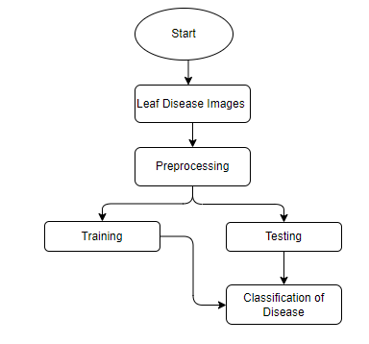
BLOCK DIAGRAM

Slide 11
Advantages:
Accurate classification
Less complexity
High performance
Easy Identification

Slide 12
MODULES
System
User
1. System:
1.1 Create Dataset:
The dataset containing images of the plant disease classification images with the Plant health or not i.e., normal are to be classified is split into training and testing dataset with the test size of 30-20%.
1.2 Pre-processing:
Resizing and reshaping the images into appropriate format to train our model.
1.3 Training:
Use the pre-processed training dataset is used to train our model using CNN Deep learning and machine learning algorithms along with Resnet50 transfer learning methods.
1.4 Classification:
The results of our model are display of plant disease classification images are either with different labels

Slide 13
2. User:
2.1 Upload Image
The user has to upload an image which needs to be classified.
2.2 View Results
The classified image results are viewed by user.

Slide 14
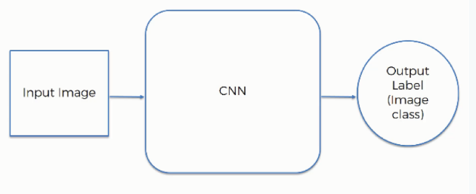
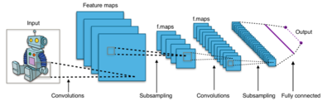
ALGORITHMS:
1. Convolutional neural network (CNN):
A convolutional neural network consists of an input layer, hidden layers and an output layer. In any feed-forward neural network, any middle layers are called hidden because their inputs and outputs are masked by the activation function and final convolution.

Slide 15
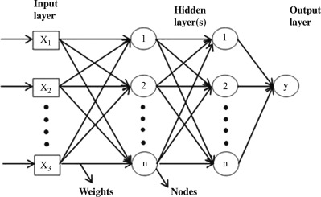
Artificial Neural Network (ANN):
ANN architecture is based on the structure and function of the biological neural network. Similar to neurons in the brain, ANN also consists of neurons which are arranged in various layers. Feed forward neural network is a popular neural network which consists of an input layer to receive the external data to perform pattern recognition, an output layer which gives the problem solution, and a hidden layer is an intermediate layer which separates the other layers. The adjacent neurons from the input layer to output layer are connected through acyclic arcs. The ANN uses a training algorithm to learn the datasets which modifies the neuron weights depending on the error rate between target and actual output. In general, ANN uses the back propagation algorithm as a training algorithm to learn the datasets. The general structure of ANN is shown in Fig.

Slide 16
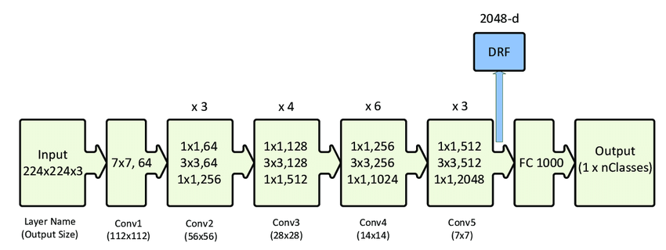
3. ResNet50:
ResNet50 is a convolutional neural network which has a depth of 50 layers. It was build and trained by Kaiming He, Xiangyu Zhang, Shaoqing Ren, and Jian Sun in their 2015 and you can access the model performance results on their paper, titled Deep Residual Learning for Image Recognition. This model is also trained on more than 1 million images from the ImageNet database. Just like VGG-19, it can classify up to 1000 objects and the network was trained on 224x224 pixels colored images. Here is brief info about its size and performance:

Slide 17
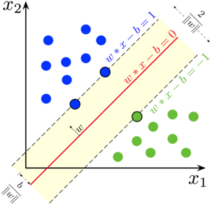
Support vector machine (SVM):
Generally, Support Vector Machines is considered to be a classification approach, it but can be employed in both types of classification and regression problems. It can easily handle multiple continuous and categorical variables. SVM constructs a Hyperplane in multidimensional space to separate different classes. SVM generates optimal Hyperplane in an iterative manner, which is used to minimize an error. The core idea of SVM is to find a maximum marginal Hyperplane (MMH) that best divides the dataset into classes.

Slide 18
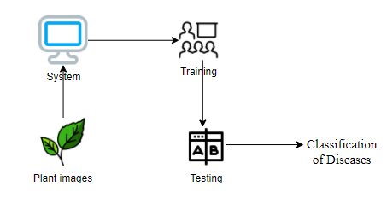
Architecture:

Slide 19
UML DIAGRAMS
Use case diagrams:
A use case diagram in the Unified Modeling Language (UML) is a type of behavioral diagram defined by and created from a Use-case analysis. Its purpose is to present a graphical overview of the functionality provided by a system in terms of actors, their goals (represented as use cases), and any dependencies between those use cases. The main purpose of a use case diagram is to show what system functions are performed for which actor. Roles of the actors in the system can be depicted.

Slide 20
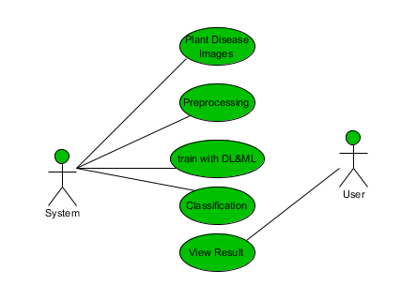

Slide 21
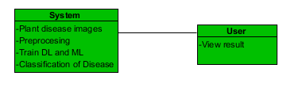
CLASS DIAGRAMS:
In software engineering, a class diagram in the Unified Modelling Language (UML) is a type of static structure diagram that describes the structure of a system by showing the system's classes, their attributes, operations (or methods), and the relationships among the classes. It explains which class contains information

Slide 22
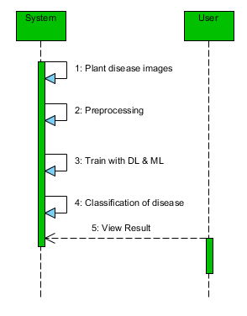
SEQUENCE DIAGRAMS:
A sequence diagram in Unified Modelling Language (UML) is a kind of interaction diagram that shows how processes operate with one another and in what order. It is a construct of a Message Sequence Chart. Sequence diagrams are sometimes called event diagrams, event scenarios, and timing diagrams.

Slide 23
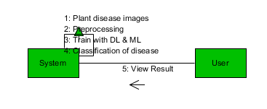
COLLABORATION DIAGRAM:
In collaboration diagram the method call sequence is indicated by some numbering technique as shown below. The number indicates how the methods are called one after another. We have taken the same order management system to describe the collaboration diagram. The method calls are similar to that of a sequence diagram. But the difference is that the sequence diagram does not describe the object organization whereas the collaboration diagram shows the object organization.

Slide 24
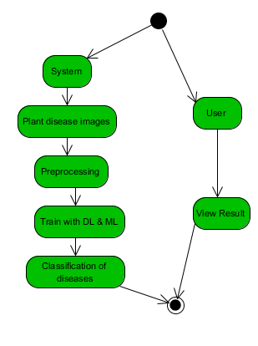
ACTIVITY DIAGRAM:
Activity diagrams are graphical representations of workflows of stepwise activities and actions with support for choice, iteration and concurrency. In the Unified Modelling Language, activity diagrams can be used to describe the business and operational step-by-step workflows of components in a system. An activity diagram shows the overall flow of control.

Slide 25
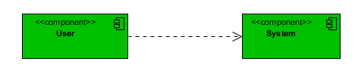
COMPONENT DIAGRAM
A component diagram, also known as a UML component diagram, describes the organization and wiring of the physical components in a system. Component diagrams are often drawn to help model implementation details and double-check that every aspect of the system's required functions is covered by planned development.

